Slide 2
Social
Media

Slide 3
2002

Slide 5
2003

Slide 6
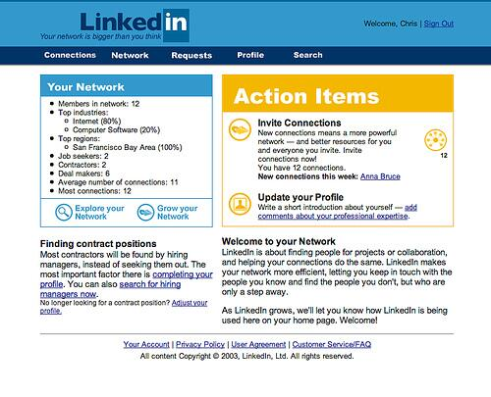

Slide 7
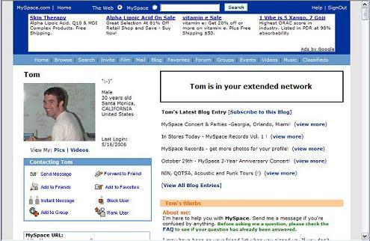

Slide 8
2004

Slide 9
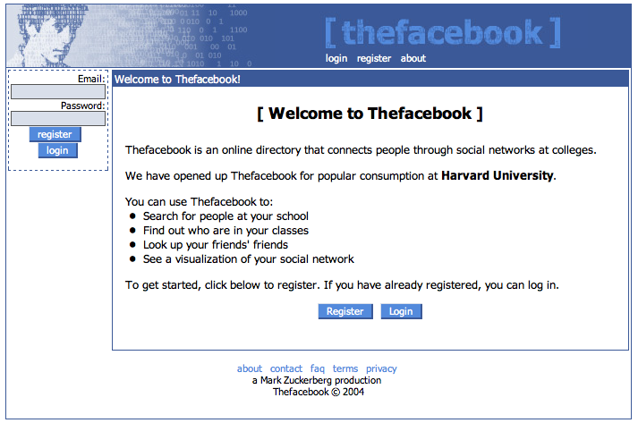

Slide 10
2017

Slide 11
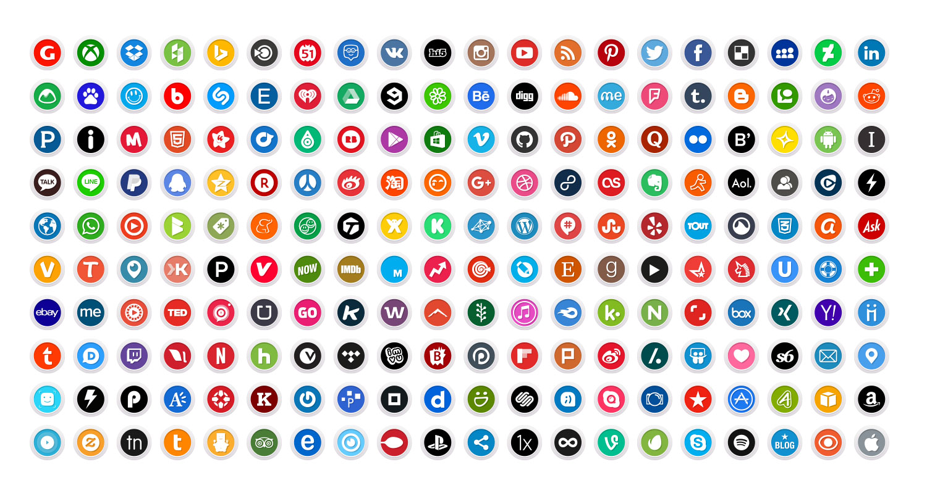

Slide 14
Facebook

Slide 15
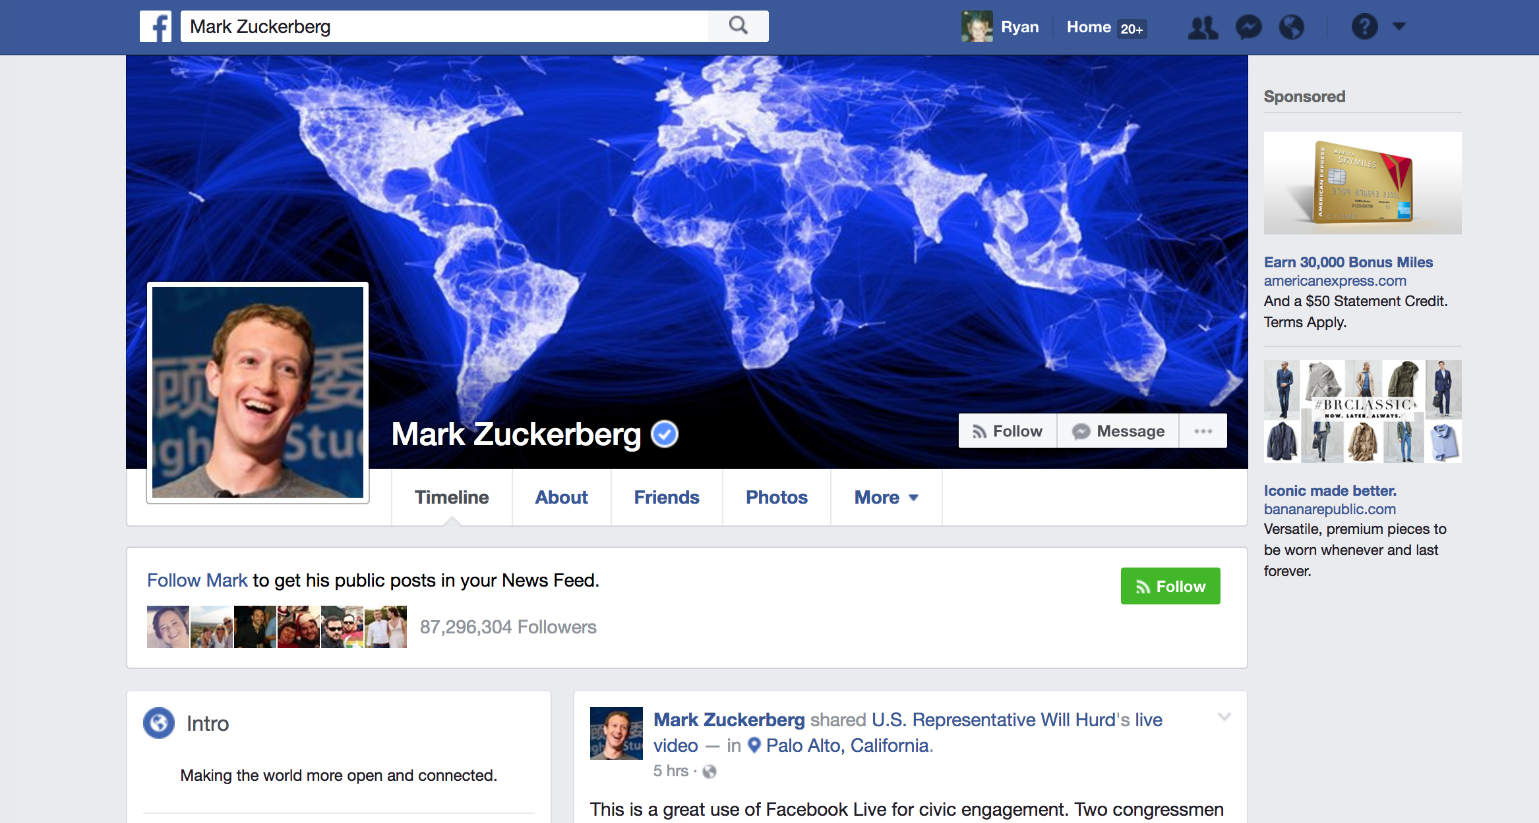

Slide 16
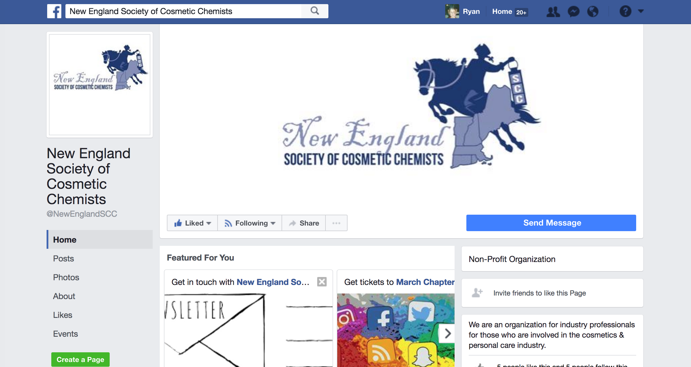

Slide 17
Video

Slide 18
Live

Slide 19
Carousels

Slide 20
Twitter

Slide 21
#hashtags

Slide 22
Live

Slide 23
Moments

Slide 24
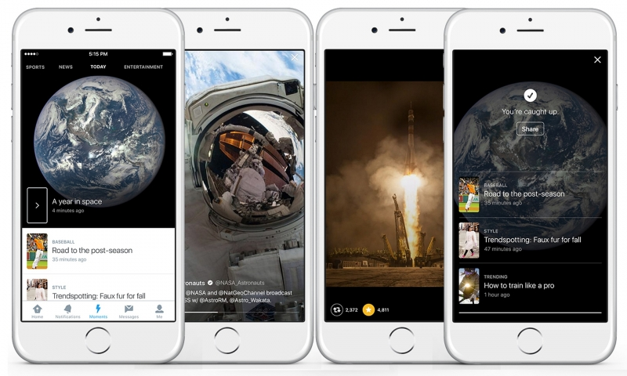

Slide 25
Instagram

Slide 26
Live

Slide 27
LinkedIn

Slide 28
Live
(just kidding)

Slide 29
Articles

Slide 30
Snapchat

Slide 31
Pinterest

Slide 32
Paid Opportunities

Slide 33
Facebook
Twitter
Instagram
Snapchat

Slide 34
Fun
Facts

Slide 35
Algorithms

Slide 36
Link Tracking

Slide 37
Copyrights

Slide 38
ROI

Slide 39
Tools

Slide 40
In-Platform

Slide 41
Third Party

Slide 42
Organization

Slide 43
Other Channels

Slide 44
Websites

Slide 45
SEO

Slide 46
Email

Slide 47
What’s
Next?

